Slide 1


NATURAL LANGUAGE PROCESSING INNOVATIONS
Roman Urdu Named Entity Recognition

Slide 2
Why This Matters
01
Widespread Use
Roman Urdu is a dominant form of digital communication in Pakistan, used extensively on social media platforms.
02
Lack of Tools
There are currently no effective NER tools for Roman Urdu, hindering its processing and understanding by machines.
03
Research Gap
This project aims to fill a critical research gap by developing tailored resources for Roman Urdu NER applications.

Slide 3
The Challenges / problem of Roman Urdu NER lies in its inherent complexities:
  Noisy Text: Roman Urdu is often informal, leading to variations in spelling and grammar.
  Mixed Language Usage: Many users incorporate English words, complicating entity recognition.
  Lack of Resources: There are no annotated datasets available for training models, resulting in machines struggling to identify entities accurately.

Slide 4
Research Gap
Lack of Datasets
Annotation Challenges
Few resources exist for Roman Urdu NER, limiting advancements in natural language processing technologies.
There is no standardized approach to annotating Roman Urdu, complicating data consistency and quality.

Slide 5
Proposed Methodology
01
Data Collection
Gather diverse Roman Urdu chat data from social media platforms to ensure comprehensive coverage of language usage.
02
Annotation Scheme
Use the BIO annotation scheme for marking named entities, ensuring clarity and standardization in the dataset.
03
Model Evaluation
Implement baseline models like CRF/BiLSTM before fine-tuning with transformer models for enhanced accuracy and performance.

Slide 6
Expected Outcomes
01
NER Dataset
A comprehensive Roman Urdu NER dataset will be developed to support future research in this domain.
02
Trained Models
Both baseline and transformer models will be trained, enhancing the accuracy of entity recognition in Roman Urdu.
03
Evaluation Report
An evaluation report will provide insights on model performance, establishing benchmarks for future advancements in NER.

Slide 7
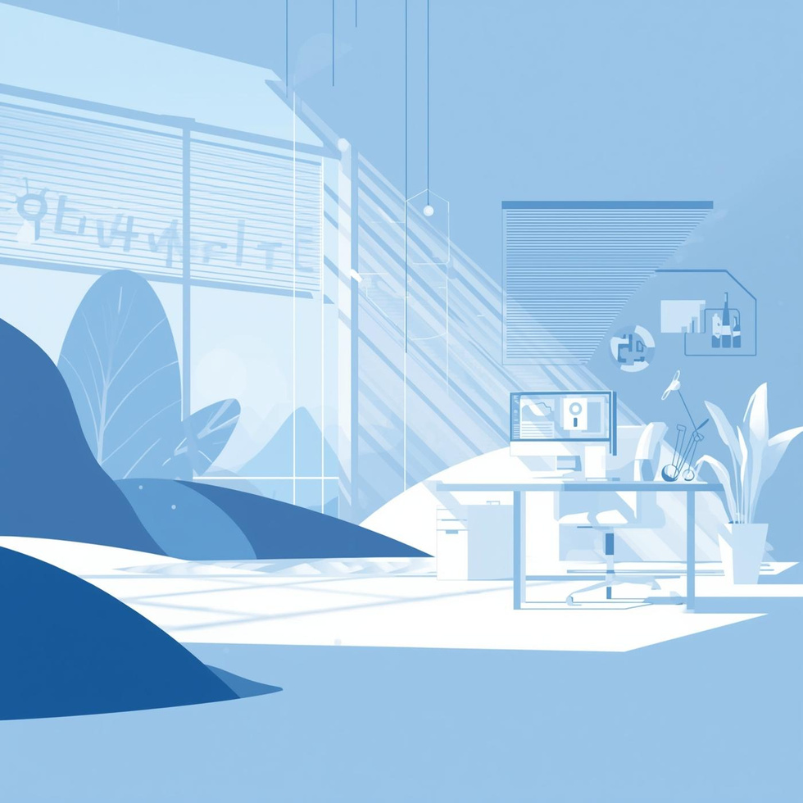
THANK YOU

